Slide 1
Engineering
Induction Training Program
(E-ITP)
Project Management
Part 1

Slide 2
Topics
Introduction
Project Management Process
Project Initiation and Start-up
Project Planning and Staffing

Slide 3
Introduction

Slide 4
Why Project Management?
Change is a constant theme in industry
  Organizational structures and processes are changing
  Product development is becoming more integrated
  Time to market and cycle time are key success factors
PM has been proven to be an essential competency with which to manage change
  Professional recognition, skill sets, career paths have been established
  Motorola Corporate Engineering and Project Management Council (CEPMC) has set competency standards and a goal

Slide 5
Project Management at Motorola
Nine Project Management Competencies
  Building Customer Relationships & Stakeholder Expectations
  Leadership
  Project Management Tools & Information Technology
  Monitor Project Performance
  Business Accuracy
  Management Skills
  Project Execution
  Project Management Knowledge
  Project Planning
Skills vs. Competencies
like the iceberg...

Slide 6
Why Plan?
Eliminate or reduce uncertainty
Improve efficiency of the operation
Obtain a better understanding of the project objectives
Provide a basis for monitoring and controlling work

Slide 7
Planning Rules-of-Thumb
Rule number one, PLAN TO RE-PLAN
Exercise strict change control
Plan for contingencies
Develop an appropriate Work Breakdown Structure (WBS)

Slide 8
Planning Rules-of-Thumb
Planning is an ongoing activity and iterations are inevitable...
ACT
PLAN
CHECK
DO
Deming Cycle for continuous improvement

Slide 9
What is a Project?
A project is an undertaking requiring concerted effort, which is focused on developing and/or maintaining a specific product
The product may include hardware, software, services and other components
Typically a project has its own funding, cost accounting, and delivery schedule
Software Engineering Institute (SEI) Capability Maturity Model (CMM)

Slide 10
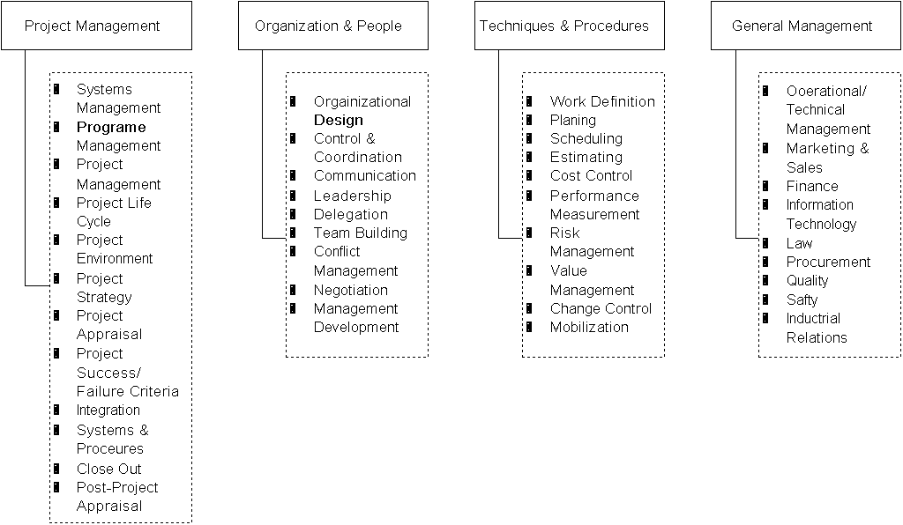
Project Management
Body of Knowledge
Source: UK-Based Association for Project Management (APM) Body of Knowledge

Slide 11
AIRLIE SOFTWARE COUNCIL’S “PRINCIPLE BEST PRACTICES”
FORMAL RISK MANAGEMENT
USER MANUAL AS SPECIFICATION
INSPECTIONS, REVIEWS, AND WALKTHROUGHS
METRICS BASED SCHEDULING AND TRACKING
BINARY QUALITY GATES AT THE INCH-PEBBLE LEVEL
PROGRAM-WIDE VISIBILITY OF PROJECT PLAN AND PROGRESS VERSES PLAN
DEFECT TRACKING AGAINST QUALITY TARGETS
SEPARATE SPECIFICATION OF HARDWARE AND SOFTWARE FUNCTIONALITY
PEOPLE-AWARE MANAGEMENT ACCOUNTABILITY

Slide 12
AIRLIE COUNCIL “PROJECT CAVEATS” OF WORST PRACTICES (1)
Caveat 1: DON’T USE SCHEDULE COMPRESSION TO JUSTIFY THE USAGE OF NEW TECHNOLOGY ON ANY TIME CRITICAL PROJECTS
Caveat 2: DON’T SPECIFY IMPLEMENTATION TECHNOLOGY IN THE Memorandum of Understanding (MOU)
Caveat 3: DON’T ADVOCATE USE OF UNAPPROVED “SILVER BULLET” APPROACHES
Caveat 4: DON’T EXPECT TO RECOVER FROM ANY SUBSTANTIAL SCHEDULE SLIP (10% OR MORE) WITHOUT A CORRESPONDING REDUCTION IN THE FUNCTIONALITY TO BE DELIVERED
Caveat 5: DON’T PUT ITEMS OUT OF PROJECT CONTROL ON THE CRITICAL PATH

Slide 13
AIRLIE COUNCIL “PROJECT CAVEATS” OF WORST PRACTICES (2)
Caveat 6: DON’T EXPECT TO TO ACHIEVE LARGE, POSITIVE IMPROVEMENTS (10% OR MORE) OVER PAST OBSERVED PERFORMANCE
Caveat 7: DON’T BURY ALL PROJECT COMPLEXITY IN THE SOFTWARE (AS OPPOSED TO THE HARDWARE)
Caveat 8: DON’T CONDUCT THE CRITICAL SYSTEMS ENGINEERING TASKS (PARTICULARLY THE HARDWARE/SOFTWARE PARTITIONING) WITHOUT SUFFICIENT SOFTWARE EXPERTISE
Caveat 9: DON’T BELIEVE THAT FORMAL MANAGEMENT REVIEWS PROVIDE AN ACCURATE PICTURE OF THE PROJECT. EXPECT THE USEFULNESS OF A FORMAL REVIEW TO BE INVERSELY PROPORTIONAL TO THE NUMBER OF PEOPLE ATTENDING BEYOND FIVE

Slide 14
People vs. Project Management (1)
People are managed through an organizational structure
  structure is based on the four cornerstones of management: delegation, authority, responsibility and supervision.
  delegation gives authority, and authority produces (and requires) responsibility
  both authority and responsibility require supervision, and effective supervision requires a suitable organizational structure.
  E.M Bennatan

Slide 15
People vs. Project Management (2)
Project Management
  A set of generic processes, organisation structures and constraints intended to achieve a defined purpose

Slide 16
What is a Program ?
A group of projects managed in a coordinated way to obtain benefits not obtained from managing them individually. - PMBOK
Program A
Program B
Project 1
Project 2
Project 3
Project 4
Project 5
Inter-related projects...
Project 6
Ongoing projects...

Slide 17
What is Project Management ?
A process that utilizes the appropriate resources and skills of the organization to successfully achieve specific objectives with clearly identified benefits.
Application of knowledge, skills, tools and techniques to achieve project objectives while balancing:
  Stake holder’s needs and expectations
  Scope, Time, Cost, and Quality
  Identified requirements and unidentified requirements
  PMBOK (Project Management Body of Knowledge)

Slide 18
Understanding Projects:
Managing Project Parameters
COST
TIME
SCOPE
and
QUALITY
RESOURCES
Wysoki, 1995

Slide 19
Tradeoffs
Ultimately there are only a few factors that are under a Project Manager’s direct control
  Functionality
  People
  Cost
  Time
  Quality
What is the relationship between these factors? If one increases, can the others remain unchanged?

Slide 20
Understanding Projects:
Identifying Impacts
Business Value
Low
High
High
Risk
Low

Slide 21
Risk Assessment
Risks can be quantified. Each risk must be identified and assigned two numbers.
Prepare a list of things that can go wrong
Estimate the Cost of each (i.e. severity or impact) on a scale of 1-10
Estimate the Probability of each (i.e. likelihood of occurrence) on a scale of 1-10
Multiply these two numbers together (Relative Priority Number)
Sort and rank items by this RPN (from highest to lowest)
The items at the top need to be addressed first and have contingency plans (or action plans) prepared for them

Slide 22
Understanding Projects:
Planning for Progress
2/3 time and 3/4 progress.
Progress
1/3 work done and
three-quarters time gone!
Progress
Time
1/3 time and 1/4 progress.
Progress
Time
Little time to ramp-up
and learn!
Time

Slide 23
Project
Management
Establish Objectives
Plan
Organize
Integrate
No
Are
Objectives
met ?
Measure
Revise
Yes

Slide 24
Project Management
Process

Slide 25
Project Management Process
Define Scope
& Commit
Organization
Project Initiation & Start-up
Project Planning & Team Formation
Project Tracking & Control
Project Delivery & Support
Develop Plan
Execute Plan
Track and
Control
Deliver
Product and
Close Project

Slide 26
Project Initiation and Start-up
Identification of customer/market
Feasibility study
Project proposal
Negotiation
Project start-up

Slide 27
Project Planning & Team Formation
1. Initiation
2. Scope
3. Work Breakdown Structure
4. Product Breakdown - Architecture
5. Organizational Relationships
6. Estimation
7. Schedule
8. Risks
9. Resourcing
10. Negotiation

Slide 28
Project Tracking & Control
1. Team Meetings
2. Schedule Tracking
3. Action Tracking
4. Project Previews
5. Project Reviews
6. Post Mortems
7. Customer Asset Tracking

Slide 29
Project Delivery and Support
Project deliverables
Delivery media
Maintenance
Post delivery

Slide 30
Project Initiation and
Start-up

Slide 31
Project Initiation and Start-up
Identification of customer/market
Feasibility study
Project proposal
Negotiation
Project start-up

Slide 32
Identification of Customer/Market
Initial marketing efforts
  Personal relationships
  Domain expertise
  Track record
  CMM level
Customer dialogue

Slide 33
Feasibility Study
May or may not be needed
  How well-defined is the need?
May or may not be funded by the customer
  Letter of authorization from customer
Initial requirements gathering needed (may require travelling to customer sites)
Technical feasibility
Market feasibility
Resource feasibility

Slide 34
Project Proposal
Executive Summary
  Functional summary
  Benefits to the customer
System Architecture
  What is being built
Project Plan
  Major deliverables
  Delivery dates
Cost
  Cost per headcount
  Fixed cost contract

Slide 35
Negotiation
Product features
  Prioritised, realistic, clearly understood, measurable
Schedule
  Start and end dates, milestones, product releases
Budget
  Staff, software, hardware, travel
Team profile
  Availability, skill set
Business considerations
  Risk sharing
  Ownership of intellectual property

Slide 36
Project Start-up
Choose a name for the project
Set up project Web presence
Project Announcement
Project Kick-Off meeting -
  official beginning of the project...
  Management budgets for estimated resource & facilities
  Management recruits and develops staff and skill sets
  Systems role identifies system requirements, sets-up accounts, proposes and purchases required hw/sw
  Technology role advises on tools, training
  Quality role plans for quality support, sets goals

Slide 37
Project Initiation and Start-up Review
Identification of customer/market
Feasibility study
Project proposal
Negotiation
Project start-up

Slide 38
Project Planning and
Staffing

Slide 39
Project Team Roles:
Project Manager (PM)
Is responsible for the planning, tracking and control of one or more projects
Employs the allocated resources to conduct the project effectively and efficiently
Is responsible for the content of non-technical project documents (e.g. SPMP, SQAP, SCMP, MBOOK & Project Folder)
Is accountable to the Operations Manager
May also be called the Project Lead (PL)

Slide 40
Project Team Roles:
Technical Lead (TL)
Is the senior designer for the software team
Is responsible for the conduct of technical tasks on a project and for the correctness of the artifacts produced
Is responsible for the approval of all technical documents (e.g. REQB, HDD, etc.)
Maintains the principal technical contact with the customer
Maintains ownership of:
  The specific development methods for the project, and their observance
  All technical architectural and design decisions and trade-offs
  Implementation to relevant standards, and the general quality of the technical components of the project

Slide 41
Project Team Roles:
Configuration Manager (CM)
Is responsible for planning, implementing, maintaining and archiving Configuration Items
Is responsible for establishing and maintaining the integrity of project baselines
Is responsible for Configuration Status Accounting activity on the project

Slide 42
Project Team Roles:
Test Engineer (TE)
Is responsible for the planning, conduct and reporting of verification activities on the project
Is responsible for the development of test suites
Maintains the traceability of requirements through to test
A Software Test Lead (STL) may be assigned to a test team within a large project
  test team can be formed as a project team carrying out a software test project

Slide 43
Project Team Roles:
Software Engineer (SE)
SEs ultimately determine the success of the project
SEs make significant contributions to team activities
  WBS
  Estimation
  Problem solving
  Project tracking
  Process improvement
SEs can be specialists
  Domain specialist (e.g. CDMA, SmartCard)
  Methodology specialist (e.g. OO, Structured Analysis)
  Technical specialist (.e.g. Unix, C++, Java, GUI)

Slide 44
Project Team Roles:
Quality Engineer (QE)
Monitors and reports on individual project compliance to contract and project plans and project application of identified customer needs
Participates in organizational meetings and reviews, project previews and post-mortems
Analyses data and submits reports to support the organizational metrics program

Slide 45
Project Team Roles
Project team roles are not positions
Project team roles are assumed for the duration of the project
An engineer can assume different project team roles on different projects
Project team role responsibilities are defined in the Software Production Process (SPP)
Software Engineer is a job title, and Software Engineers can assume various project team roles

Slide 46
Project Support Roles:
Quality Specialist (QS)
Performs verification, validation and guidance on project planning and tailoring. Participation in the development of project standards and processes
Conducts system, process, product and configuration audits. Performs formal acceptance activities for product release
Can participate in organizational meetings and reviews, project previews and post-mortems

Slide 47
Project Support Roles: Software Engineering Technology Center
Develop proposals for projects and research activities to improve system availability, reliability, product quality and developmental cycle time
Plans, conducts, assesses and reports on technology pilots, and co-ordinates the implementation of new technologies
Participates in projects aimed at achieving reduction in cycle time; six sigma quality; the implementation of the Software Engineering Institute, Capability Maturity Model; and other continuous improvement programs
Performs software engineering activities related to the customisation and integration of software tools
Develops and conducts technical training courses

Slide 48
Project Support Roles:
Information Technology Engineer
Installs, configures and manages computer and network hardware as required
Manages software applications including installations, upgrades, license administration and maintenance
Provides user assistance in operational aspects of the Center’s computer systems and applications packages where appropriate
Communicate with vendors, contractors and other Motorola support staff, both internal and external, on purchases and operational support matters

Slide 49
Organizational Managers:
Operations Manager (OPM)
Identify new product and business opportunities
Prepare and manage staffing needs, departmental budgets, forecasts and related financial data
Oversee project and program progress to ensure the organizational goals of Total Customer Satisfaction, Cycle Time Reduction, 6 Sigma Quality and High Maturity Software Process are followed
Establish and communicate performance standards across the engineering organization
Dialogue with Program Managers and Technical Leader personnel concerning career planning, skills development, training needs and offer assistance in handling Human Resource management issues

Slide 50
Organizational Managers:
Program Manager (PGM or PM)
Meet with customers to discuss possible projects and opportunities and negotiate project schedules and resources
Oversee the scheduling and tracking of projects and provide necessary reports to appropriate people. Decide on software languages, CASE tools, methodologies, hardware platforms, etc. to be used
Provide technical guidance to project teams and act as a liaison in overcoming obstacles
Dialogue with subordinates concerning performance, career interests, skills development, training plans and other related topics
Ensure adherence to quality procedures and standards and customer satisfaction for all projects within the program

Slide 51
Project Roles and Responsibilities
Project Team Roles
  Project Manager or Lead (PM or PL)
  Technical Lead (TL)
  Configuration Manager (CM)
  Test Engineer (TE)
  Software Engineers (SE)
  Quality Engineer (QE)
Project Support Roles
  Quality Specialist (QS)
  Software Engineering Technology Center (SETC)
  Information Technology Engineer (IT)
Organizational Managers
  Operations Manager (OPM)
  Program Manager (PGM or PM)

Slide 52
Change History
Vers. A.1 July 2001
  New format and revision E-ITP PM Week 1 from prior source materials
Vers. A.2 31 August 2001
  Updated format and separated into 4 presentations
Vers. A.3 17 May 2002
  Adapted project roles from MCSC
Notes:
Vers. A.3 Adapted by Alfredo Edye and Adrian Marini

